Slide 1

Center for Innovation in Teaching & Learning

Slide 2
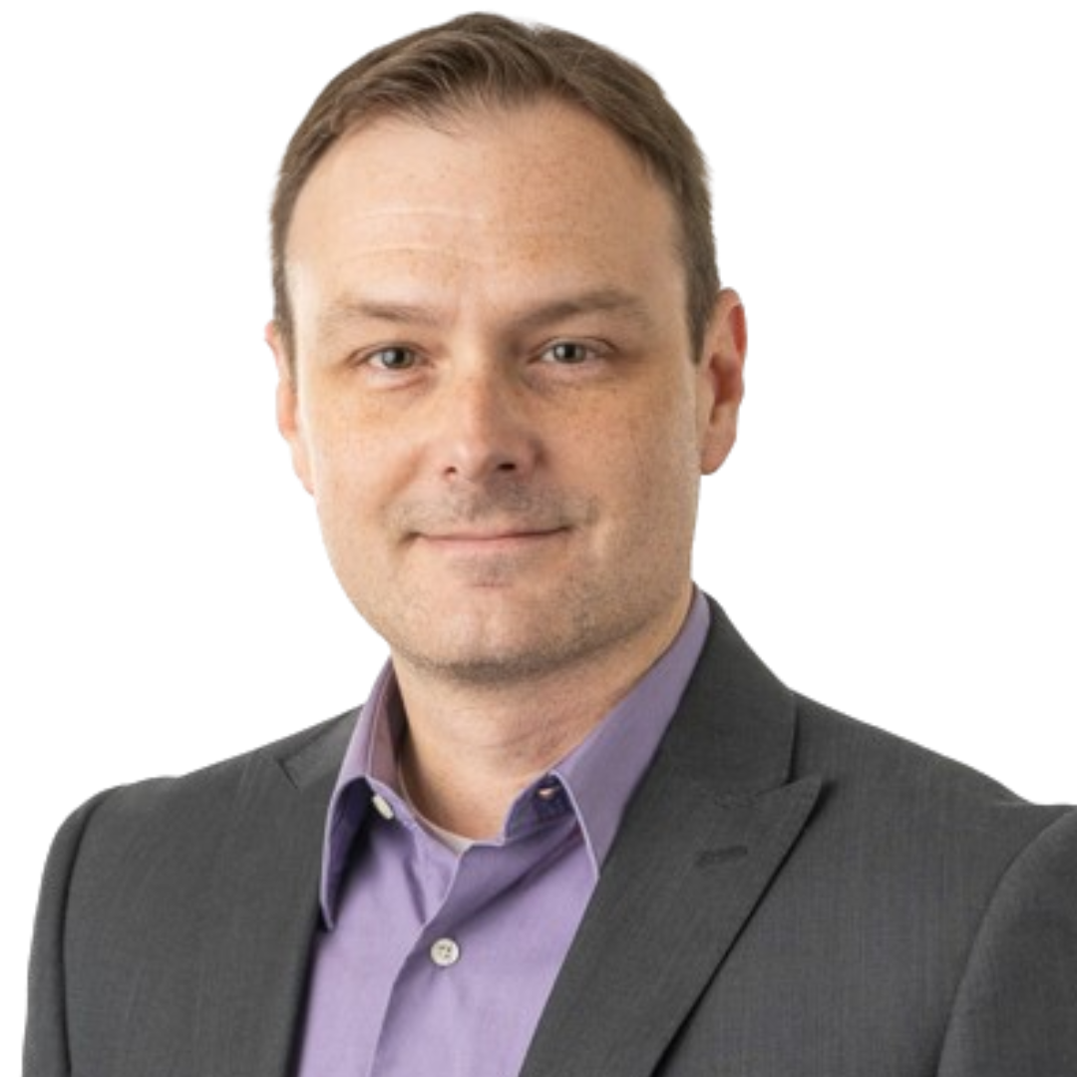


Meet the Administrative Support
Jason Beach, Ph.D.
Professor, College of Education
Director of the CITL and JLRC
Emmie Acuff, M.B.A.
Communications & Training Coordinator
Kassie Wallace
Financial Associate 3

Slide 3
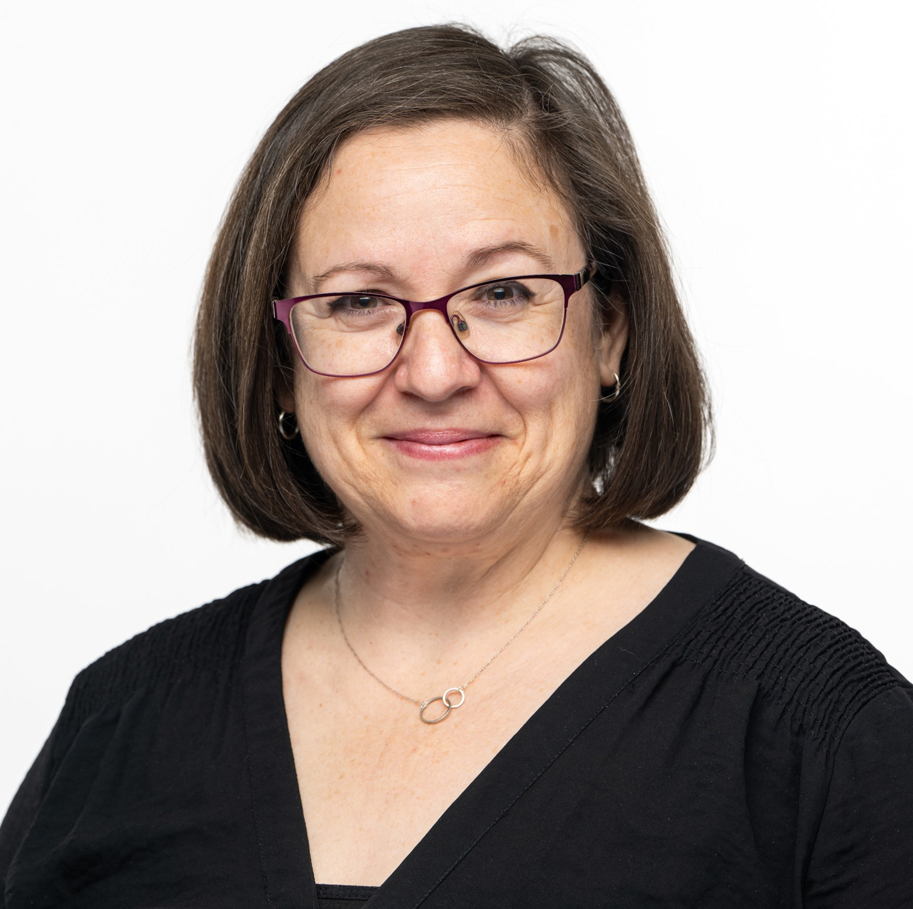



Meet the Instructional Designers
Heather Rippetoe, Ed.D.
College of Education
& Human Sciences
College of Fine Arts
Whitson-Hester School of Nursing
Mallory Matthews, Ed.S.
College of Agriculture
& Human Ecology
College of Business
College of Emerging & Integrative Studies
Lacy Means, M.Ed.
College of
Arts & Sciences
Carrie Roberson, M.A.
College of
Engineering

Slide 4
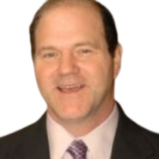

Meet the Educational Technologists
Kelvin Norman, Ed.D.
Taylor Chesson, M.A.

Slide 5

Session Resources
Check out our CITL website
Every Tuesday the CITL offers workshops
Book a consultation with a member of the CITL team!

Slide 6


D2L Brightspace (iLearn)
D2L iLearn
(LMS) Banner Courses
D2L Train
(2nd Server for HR Trainings)

Slide 7
Ways the CITL Can Help You
5

Slide 8
Agenda
Course Consultations
Mid Semester
Instructional Diagnostics
Class Observations
TN Tech Course Templates
Ed Tech Support

Slide 9
Course Consultations
1
How Do I Design My Course?

Slide 10

Course Consultation Topics
Course Design
Syllabus Creation & Revision
Course Accessibility
Student Engagement
Instructional Technology in the Classroom
Assessments

Slide 11



Course Planning
Building a New Course
Inheriting a Previous Course
Enhancing a Current Course

Slide 12

Transitioning Course Modalities
Tech-Direct (Online)
Tech-Flex (Hybrid)
Tech-Enhanced (In-Person)
Visit CITL Course Modalities for more information
Policy Central:223 - Online and Distance Education
Notes:
Tech Direct: Tech Direct refers to our Online classes. A large percentage of content is delivered through an LMS, such as ilearn
There is no on campus requirement for Tech Direct classes, unless an online program has a specific on-campus requirement such as a practicum or a co-op
and instruction and learning may be synchronous or asynchronous.
Tech Flex: Course content is delivered through both on-campus and online approaches. The online components average 40-60% but no more than 80% of course content is delivered online.
Tech Enhanced: A Tech-Enhanced course delivers content to students on-ground, or on-campus, as the primary modality, but uses technology to enhance the course by making course materials available online. This is also referred to as a “traditional” course.

Slide 13
How do I Book a Consultation?
Go to CITL Website: Bookings

Slide 14
Instructional Diagnostics
2
How Do I Gather Midterm Feedback?
Notes:
Carrie

Slide 15
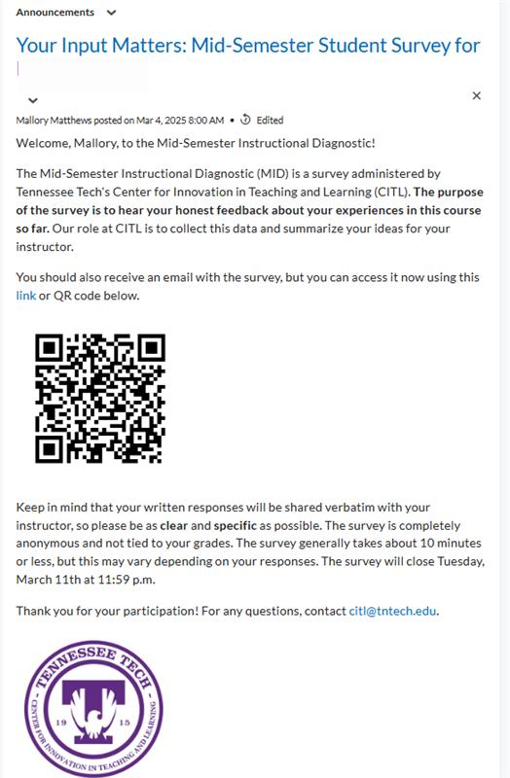
What is a MID?
Conducted outside of structured class time
Individual survey online
Provides confidential feedback
Takes place around the midpoint of a term.
Notes:
Carrie spring 2024
A representation of the different campus departments who participated in Spring 2023 can be seen in the pie chart above.
A small group instructional diagnostic, or SGID, is a simple
and straightforward evaluation process that uses structured,
small group discussions among students in a class to provide
confidential feedback to an instructor, generally around the
midpoint of a term.

Slide 16
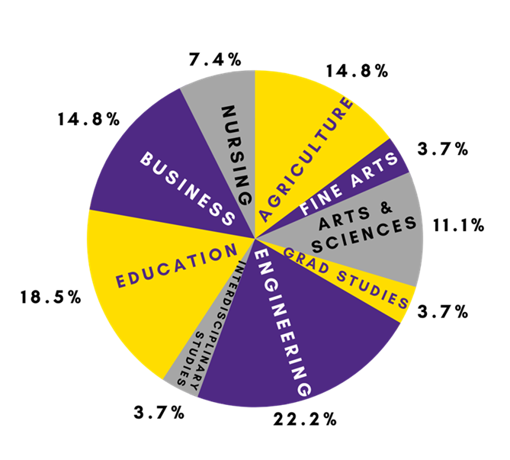
What is a SGID?
Simple and straightforward evaluation process
Uses individual responses & structured small group discussions
Provides confidential feedback
Takes place around the midpoint of a term.
Notes:
Carrie
A representation of the different campus departments who participated in Spring 2023 can be seen in the pie chart above.
A small group instructional diagnostic, or SGID, is a simple
and straightforward evaluation process that uses structured,
small group discussions among students in a class to provide
confidential feedback to an instructor, generally around the
midpoint of a term.

Slide 17



SGID Participants
Faculty
Student
CITL Facilitator
Leaves classroom
Receives feedback
Discusses results with students
Answers questions individually
Breaks into small groups to reach a consensus
Conducts discussion with students
Provides feedback to faculty member

Slide 18




Things to Note:
20-25 Minutes
NOT Tied to Assessments or Evaluations
Confidential
18

Slide 19
Survey Questions
Briefly describe at least three things you like about the course–the characteristics that you believe support your learning.
Briefly describe at least three things you dislike about the course–the characteristics that you believe hinder your learning.
What suggestions can you offer that would enhance your learning?
What can you as a student do to improve your learning?

Slide 20
Day of SGID:
Reflect individually
Reflect in small groups
"Vote" based on findings
Students will:
20

Slide 21
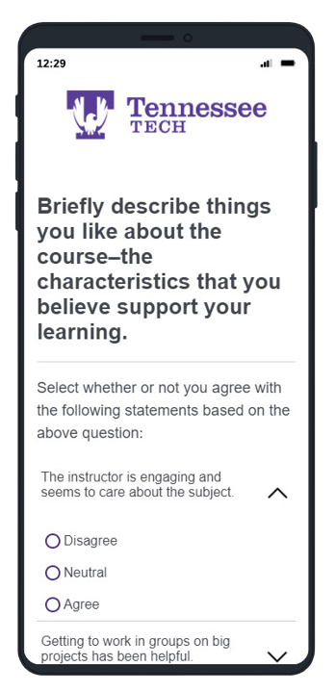

After
SGID:
CITL Facilitator will gather data and generate a report within 48 hours.
Facilitator and Instructor can meet again to discuss feedback.
Instructor takes results back to class and discusses with students.

Slide 22

After the SGID
I can’t change ______________ because…
Here is what I am changing based on SGID results…
I’m happy that you like…
22

Slide 23
Class Observations & Course Evaluations
3
How Do I Evaluate My Course?

Slide 24

On-Ground Classroom
Observation
Subject Matter Content
Organization
Rapport
Teaching Methods
Presentation
Management
Sensitivity
Assistance To Students
Physical Aspects Of Classroom
24

Slide 25

Hybrid & Online Course Review
(CITL Course Design Framework)
Based on the Online Learning Consortium scorecard
Focuses on course design elements that support effective, engaging, and accessible online and blended learning experiences
Two sections:
  Essential design – fundamental components
  Advanced design – elevate course quality
25

Slide 26

Preparation
What's going well?
How are students performing?
What are students saying/doing?
What are you curious about?
26

Slide 27

Post-Observation Meeting
What did we find?
What do we want to keep?
What do we want to change?
What do we want students to know?
27

Slide 28
Tennessee Tech Course Templates
4
How Do I Organize My Course?

Slide 29
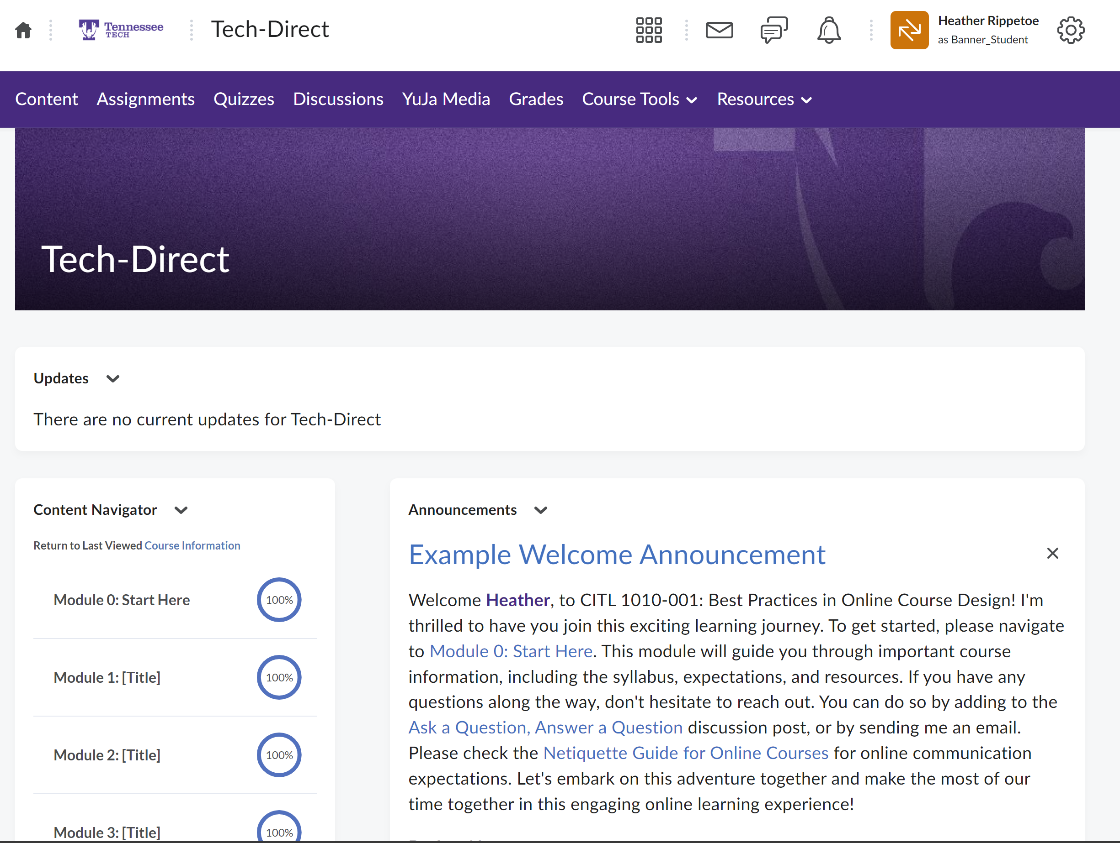
Sample Front Page:
TN Tech Course Template
29

Slide 30
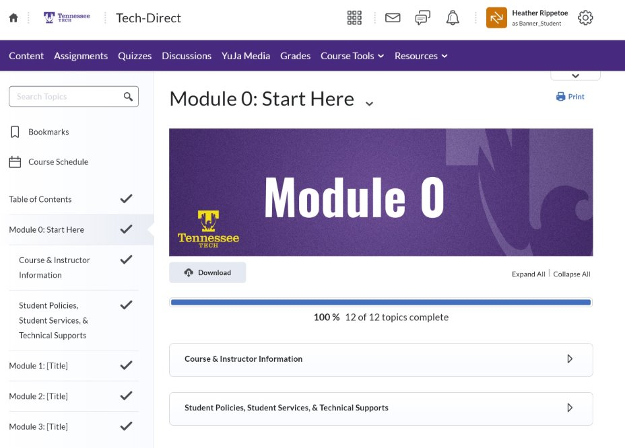
Sample Module 0:
TN Tech Course Template
30

Slide 31
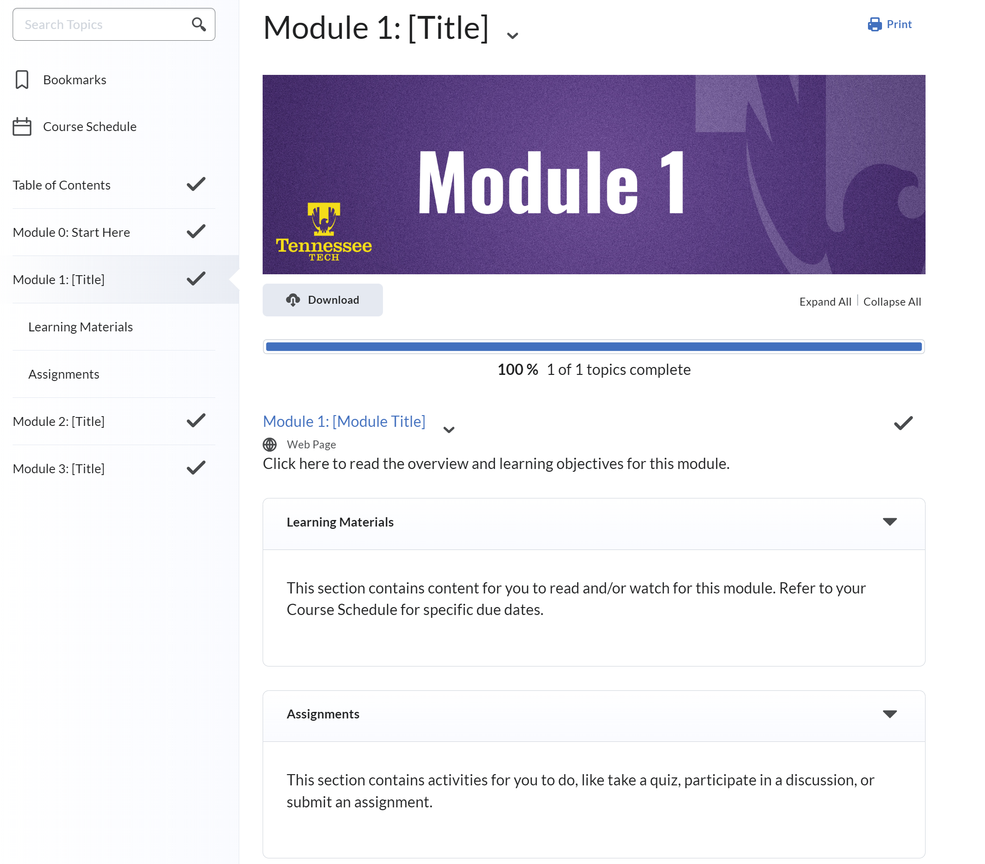
Sample Content Module:
TN Tech Course Template
31

Slide 32
Ed-Tech Support
5
How Do I Leverage Instructional Technology?

Slide 33
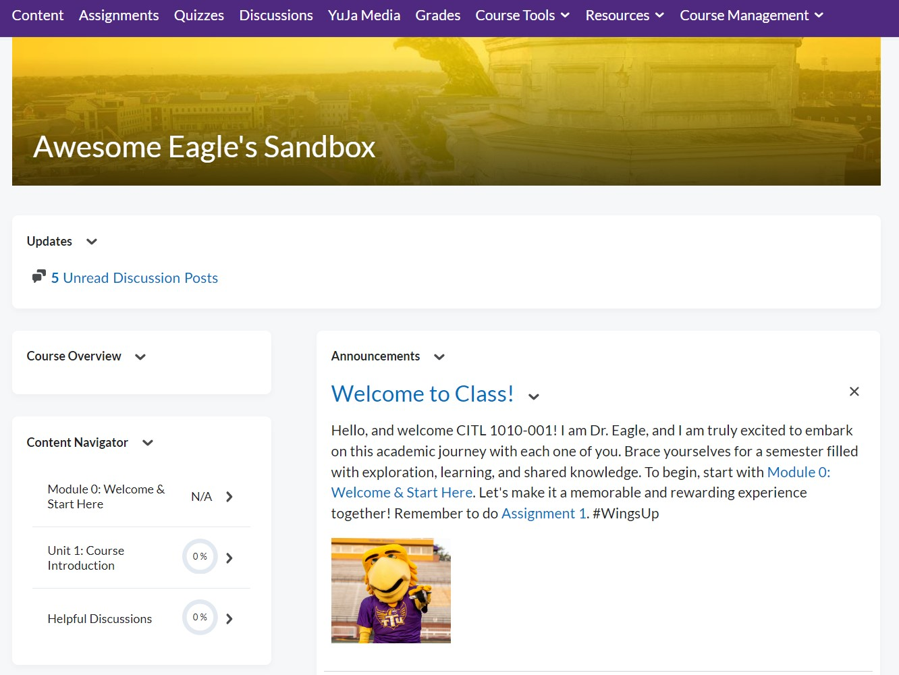
D2L iLearn
Content
Videos
Course Documents
(PowerPoints, lectures, handouts, etc.)
Activities
Discussions
Quizzes
Assignment Submissions
Grading
Rubrics
Audio & Video Feedback
Online Gradebook
33

Slide 34
Instructional Technology
Software and Technologies
  Institutional Membership
  Can Provide Administrative Support.
View the full list on CITL website
  Faculty & Students Guides
D2L / iLearn / Brightspace | YuJa Media
Teams / Zoom | Poll Everywhere
Qualtrics | Respondus
Office 365 | Turnitin

Slide 35

Yuja Media (Video Tool)
Centralized Video Management
Easy Video Embedding
Video Analytics
Captioning and Accessibility
35

Slide 36
Helpful Forms & Contact
Helpful Forms
Contact us at ilearn@tntech.edu
Book a Technology Consultation
Online iLearn Training | Student Missing Class Request Form
Create Course Master | Combine Courses
Add TA’s, Co-Instructors, or Incompletes | Create a Community Course

Slide 37
Thank You!
Questions, Comments, Concerns?
Register for our Tech Tuesday sessions:
CITL Workshops & Trainings
Resources
Instructional Tech
iLearn Resources
Previous CITL Sessions
SGID Information
Course Design
Book a Consultation

